Slide 1
ATB (Auto-Trading Bot) APP
January 22, 2024

Slide 2
Disclaimer
All strategies in this presentation are for educational purposes only. You should consult a licensed professional before implementing.

Slide 3
Key Points
Smart Automation:
Intelligent algorithms for data-driven trading decisions.
Diversification Simplified:
Explore diverse assets effortlessly.
Effortless Risk Management:
Customizable tools for a secure trading environment.
24/7 Accessibility:
Trade anytime, anywhere for maximum opportunities.

Slide 4
Investor Benefits:
Time Efficiency:
Save time on analysis; let the bot handle execution.
Data-Driven Decisions:
Make informed choices backed by data insights.
Continuous Improvement:
Adapt and refine strategies based on real-time metrics.

Slide 5
Why Choose ATB (Auto-Trading Bot) APP?
User-Friendly Interface:
Intuitive platform catering to all levels of investors.
Security First:
Robust encryption and regulatory compliance.
Transparent Performance:
Real-time analytics for portfolio monitoring.

Slide 6
Why choose us?
We’re creating profitable trading strategies by predicting and leveraging price movements in financial markets.

Slide 7
The Strategies
BLSH Strategy
______ Strategy
Thinking of a Strategy
Identify and capitalize on significant price movements when an asset's price reaches its highest level of support, signaling the potential for a profit..
In the works ….
Please stay tuned for more….

Slide 8
The Process
Data Collection and Preparation
Data Source: Yahoo Finance
AAPL 2020 - 2023 stock prices
Model Selection and Training
Supervised Learning
Feature Engineering
Model Evaluation
Performance Against Historical Data
Test Different in Market Conditions
Model Deployment and Monitoring
Deploy Model in Live Environment
Update as Market Conditions Change

Slide 9
Data Collection and Preparation
Data Source: Yahoo Finance
AAPL 2020 - 2023 stock prices

Slide 10
The Algorithm

Slide 11
Starting Balance
Starting Cash Balance: $25,000
Positions: None
Percent of Cash per trade: 5%

Slide 12
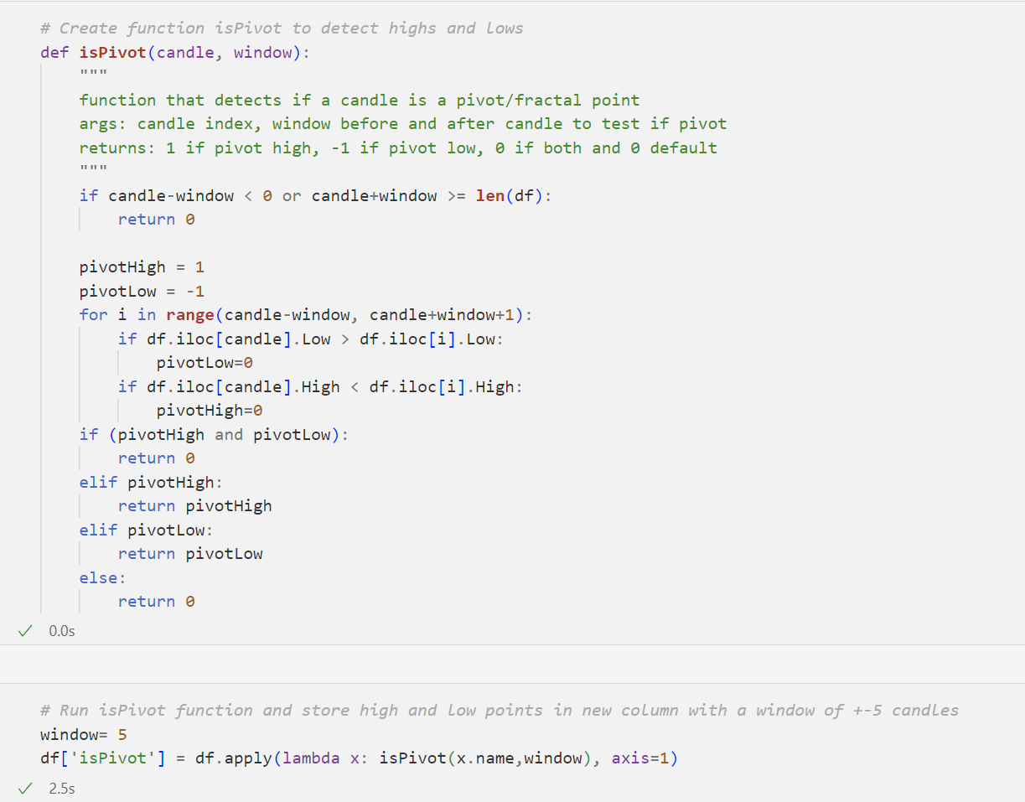
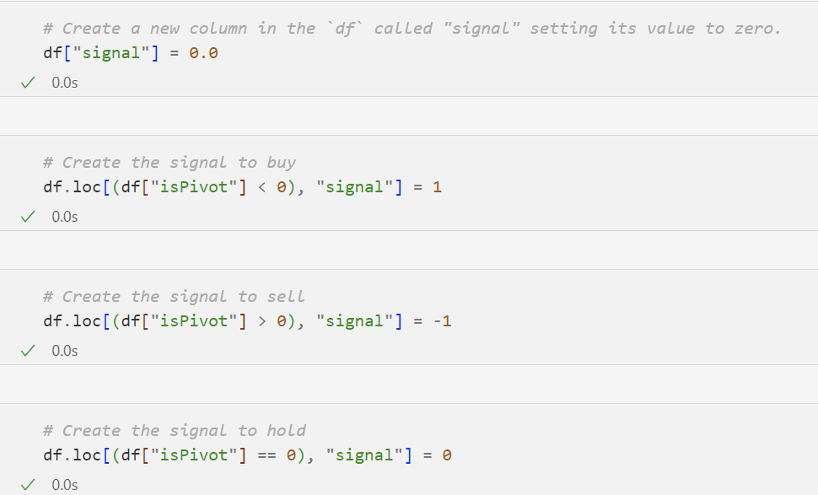
The Code

Slide 13
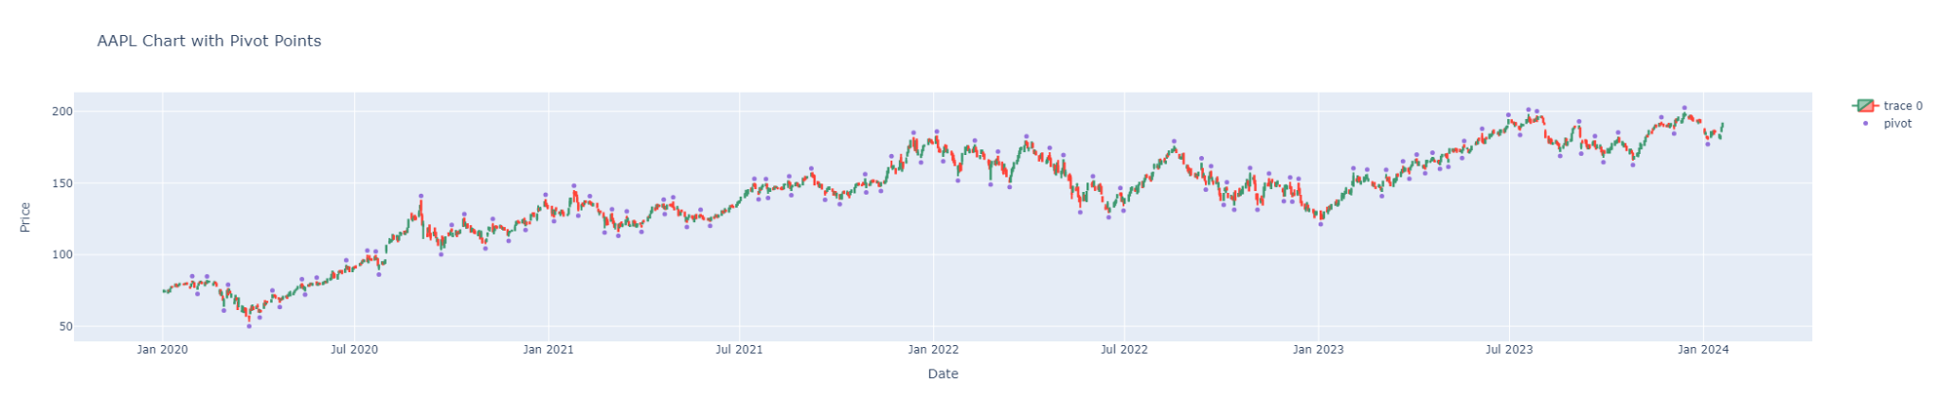
Algo Returns

Slide 14
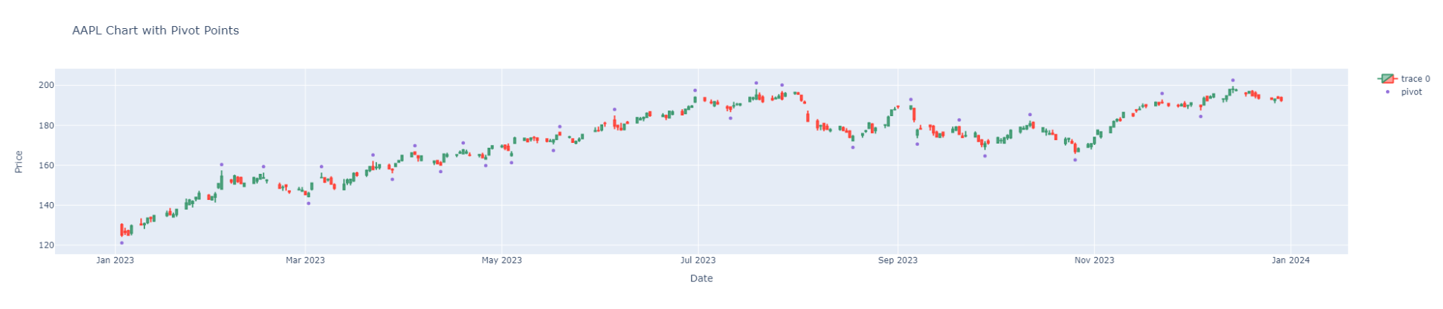
Algo Returns 2023

Slide 15
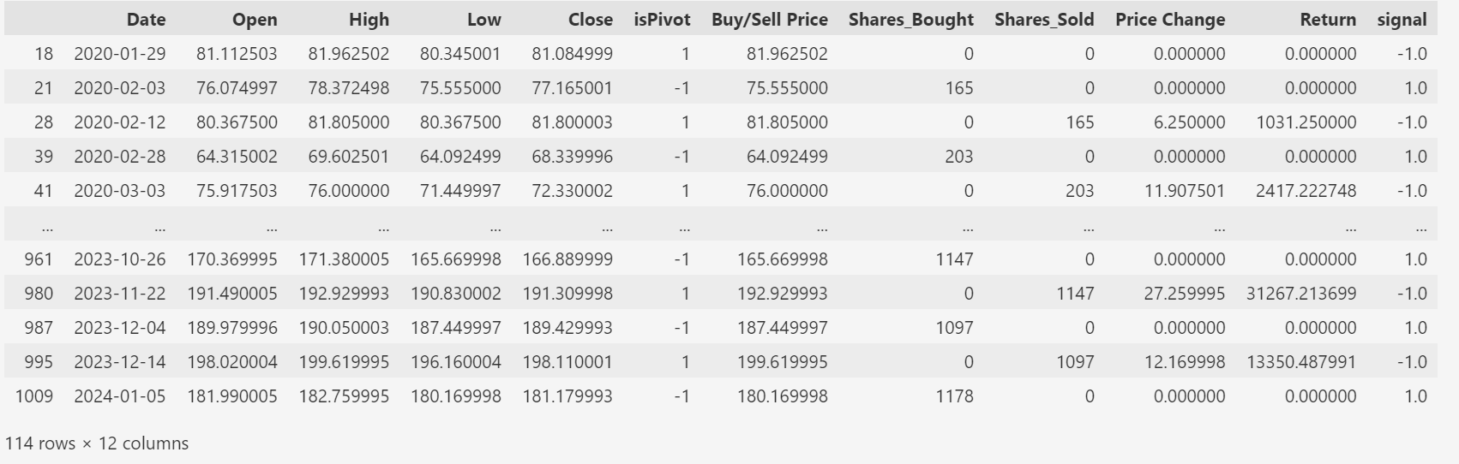
Algo Returns Dataframe View

Slide 16
Results
As of 01/19/2024
Total Cash Balance: $212,478.62
Total Returns: $399,718.88
Shares Bought: 26,429 shares
Shares Sold: 25,251 shares

Slide 17
Model Selection and Training and Evaluation
Supervised Learning - Support Vector Machine
Performance Against Historical Data

Slide 18
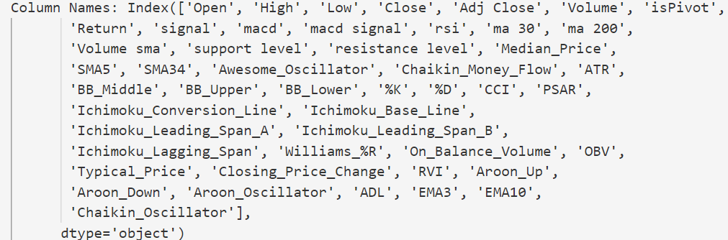
Features
Model without technical indicators
Model with technical indicators

Slide 19
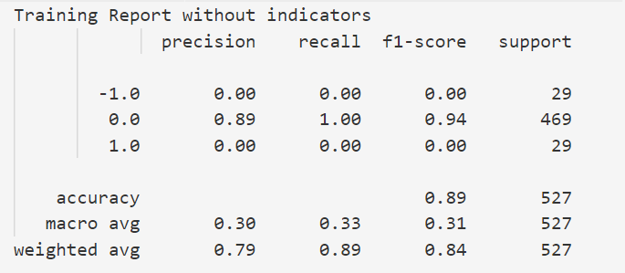
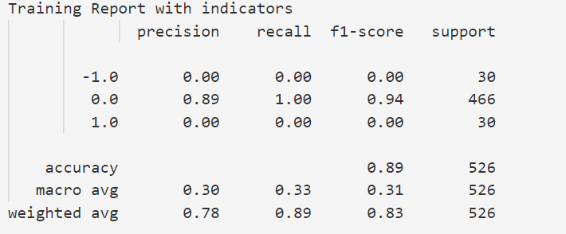
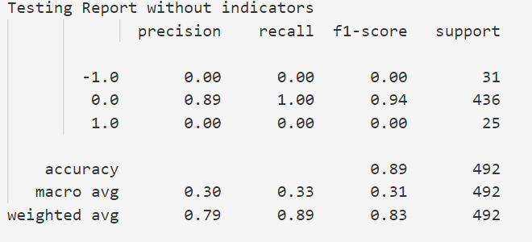
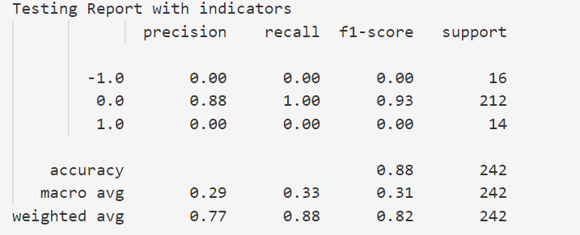
SVM Training and Testing Results

Slide 20
SVM Training and Testing Results

Slide 21
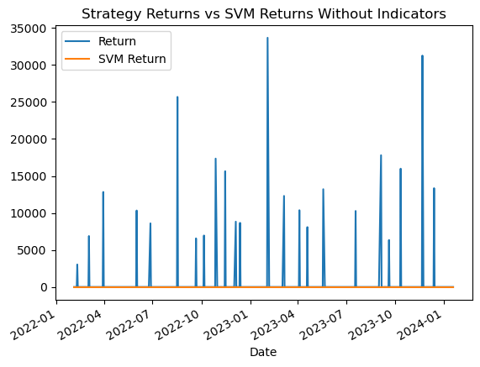
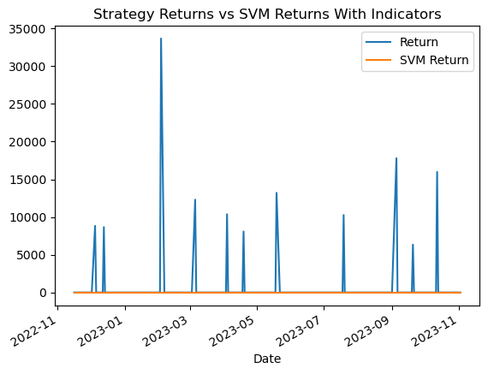
SVM Returns

Slide 22
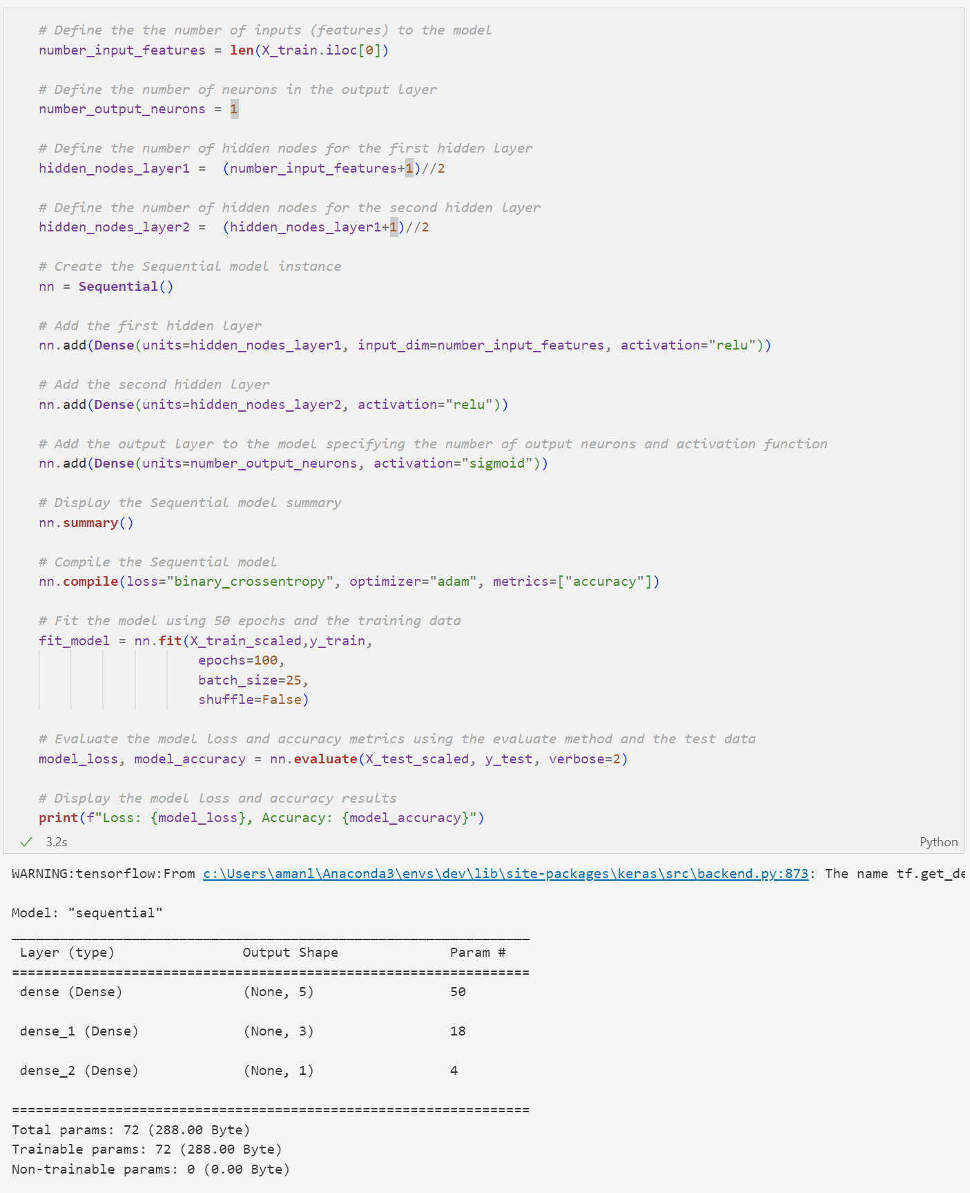
Neural Network Code

Slide 23
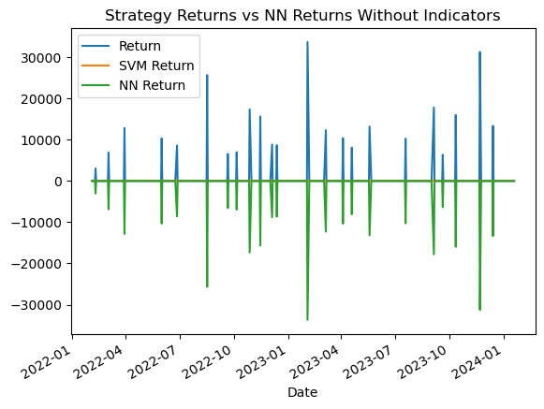
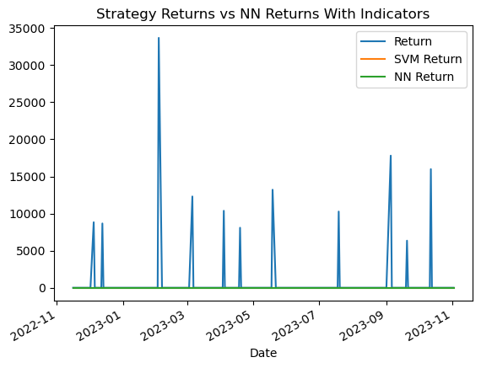
Neural Network Results
Without Indicators:
Loss: -0.36202579736709595
Accuracy: 0.8861788511276245
With Indicators
Loss: -758.6589965820312
Accuracy: 0.8760330677032471

Slide 24
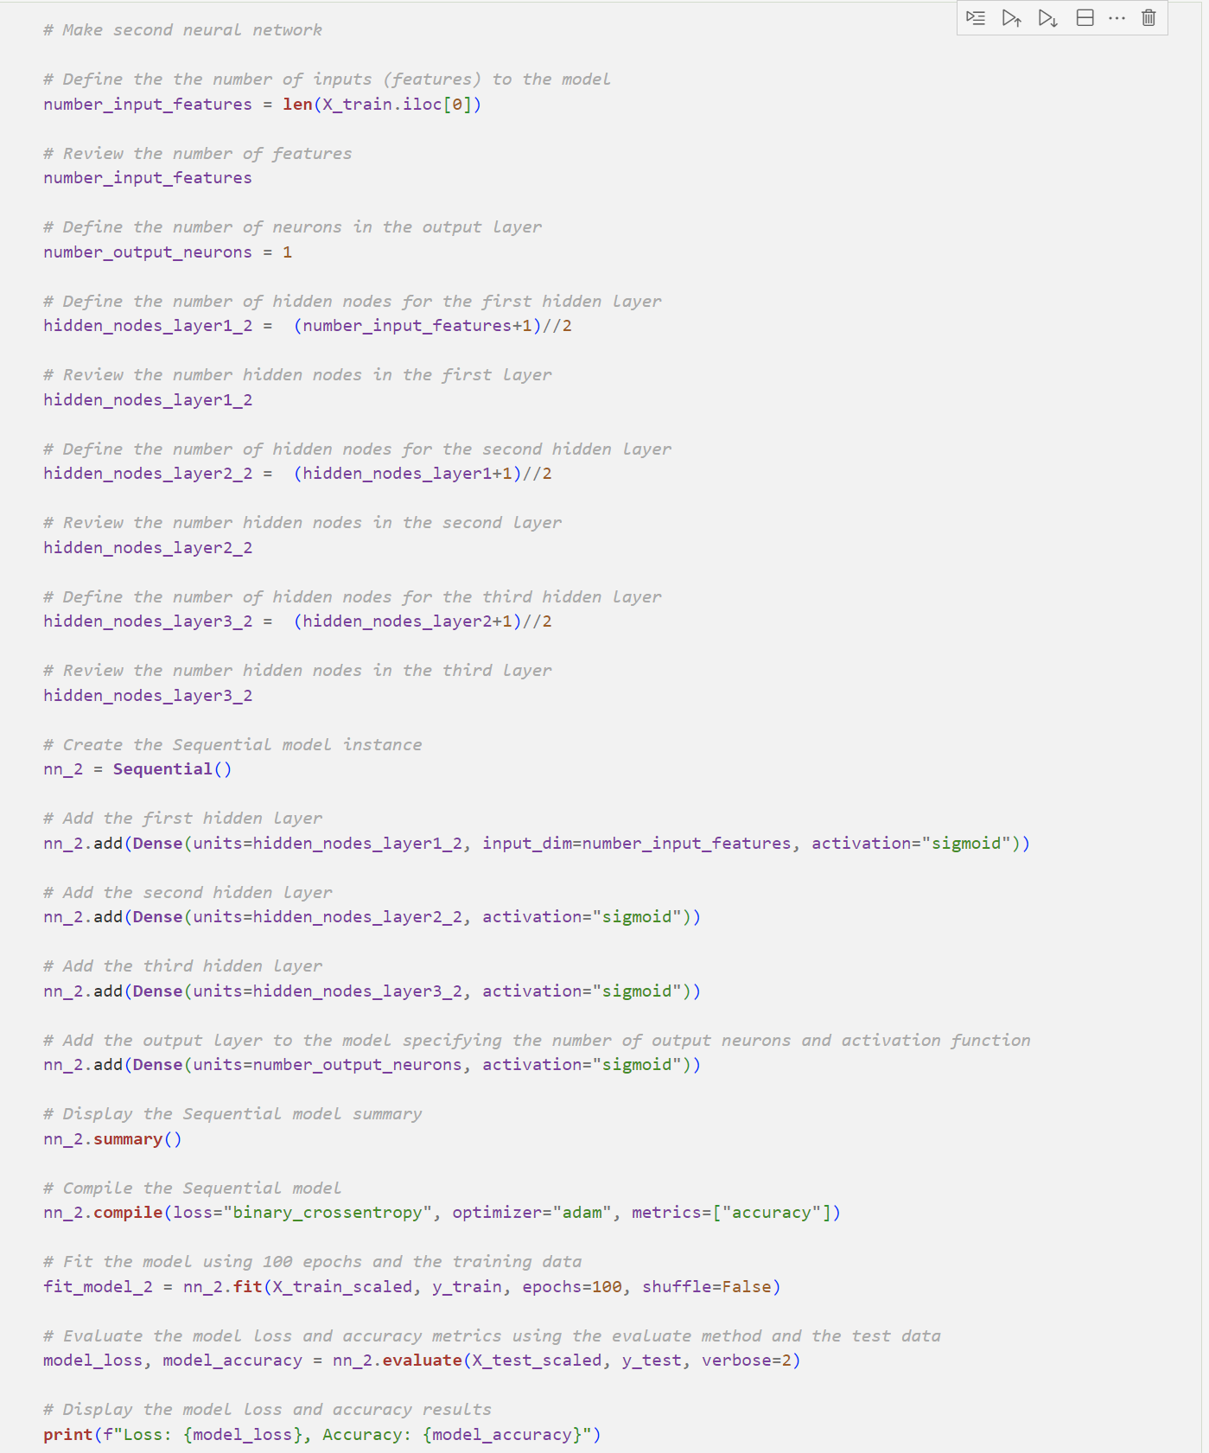
2nd Neural Network Code

Slide 25
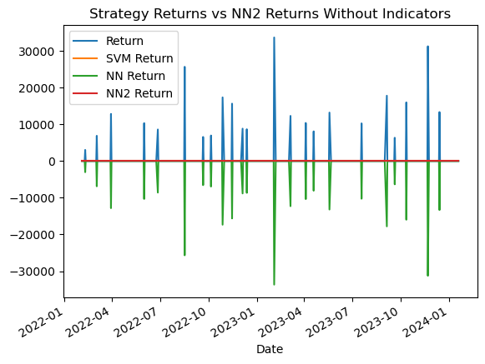
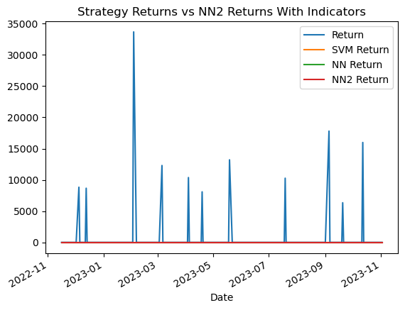
2nd Neural Network Results
Without Indicators:
Loss: 0.10725484043359756
Accuracy: 0.8861788511276245
With Indicators
Loss: -0.04243694245815277
Accuracy: 0.8760330677032471

Slide 26
The Path Forward
Add More Partners to Help Develop Models
Add Less / More Features
Try Different Supervised Learning Models
Test With Different Stocks / Cryptocurrency
Model Deployment and Monitoring
** We are recruiting! Please reach out if interested! **

Slide 27
Timeline
Jan | Feb | Mar | Apr | May | Jun | Jul | Jul
Deployment
In-production services
Go-live
Advanced projects
______ Strategy
Thinking of a Strategy

Slide 28
QUESTIONS????

Slide 29
The Team
Montgomery Gash,
Alex Horning,
Adrian Manlangit,
John Doe, Investor
Mystery investor…..
And possibly you!

